Slide 1
Unlocking the Potential: A
Journey Through
Research and AI
Innovations
By
Kudirat Abiola Adegoke (Ph.D)
Senior Lecturer
Department of Library and Information Science
Faculty of Education and Extension Services
Usmanu Danfodiyo University, Sokoto

Slide 2
Table of Contents
01
Exploring Research
02
Navigating AI in
Fundamentals Questions
Research
03
Delving into
04
Advancing
Research FAQs
Knowledge with AI
05
Ethical and Practical
06
Vision for Future
Considerations
Research

Slide 3
3. Delving into Research FARQs
What are the FARQ? They are common questions that most researchers always ask to gain a better understanding of their areas of research interests.
2. Who can ask Research Questions? Researchers: Supervisors/ Lecturers/ Students/ or Visitors to Research Websites or Institutions
3. Why do they need to ask such questions? To gain a better understanding of the project topic/ research process.
4. What do they need to do if they are not satisfied with the answer (s)? Do a thorough literature review or Consult a Librarian

Slide 4
Young researchers often face some challenges as they try to graduate or progress in their academic and professional journeys. Some of the common challenges include:
Finding a good research topic can be a big issue at the beginning of any project particularly when -
Lacks Focus;
Topic is too Broad/Narrow;
Feasibility: Trying to consider the resources available (time, budget, access to data);
Unable to determine the Originality of the findings;
Overcoming the Challenges:
Focus on Gaps: Review recent literature in your field. Look for areas where existing research is inconclusive or leaves room for further exploration.
Refine & Refocus: Once you have a broad area, ask yourself specific questions to narrow the scope. Is there a specific population, intervention, or consequence you want to focus on?
Brainstorming: Start by jotting down everything that interests you within your field. Discuss potential topics with professors, peers, or professionals to get diverse perspectives.
Consider Designs and Methodology: Think about the type of research you'd like to conduct (quantitative, qualitative, or mixed methods). This can help guide your topic selection based on what kind of data is obtainable.
Librarians are Your Helpers: Librarians at your institution or nearest library can be invaluable resources. They can help you conduct a literature search for existing research, identify relevant databases, and ensure your topic is feasible.

Slide 5
1. Exploring FARQ

Slide 7
The Research Compass: Orienting Our Inquiry
Purpose underpins our scientific inquiry, guiding us to delve into the unknown. This research seeks to illuminate, challenge, and innovate within its realm.
Understanding the intent is the first step on our intellectual voyage.
What is a Variable?

Slide 8
Examining Key Findings and Literature Gaps
A thorough literature review sets the foundation for discovery. We scrutinize the studies before us, identifying both their breakthroughs and the gaps
that beckon our curiosity.

Slide 9
There are two main types of variables:
Independent Variable: This is the variable that is manipulated or controlled by the researcher. It is the presumed cause or predictor in a study. Changes in the independent variable are hypothesized to cause changes in the dependent variable. For example, in an experiment testing “The effect of different study techniques on exam scores”, the independent variable would be [the study technique].
Dependent Variable:
This is the variable that is measured or observed in response to changes in the independent variable. It is the outcome or response variable that the researcher is interested in understanding or predicting. The dependent variable is expected to change based on variations in the independent variable. In the example mentioned earlier, the dependent variable would be “the exam scores”

Slide 10
Features of High-Impact Research
Quality research is the foundation for reliable knowledge and progress in any field. The following are what makes your research a strong one:
1. Strong Research Design:
Clear Research Question: A well-defined question sets the direction for the entire investigation.
Appropriate Methodology: The chosen method (e.g., survey, experiment) should align with the question and data collection needs (qualitative or quantitative).
Rigorous Data Collection: Data should be gathered in a reliable and unbiased way, ensuring adequate representation of the entire population by the sample for quantitative studies.
Data Analysis: The analysis should be appropriate for the data type and question, using sound statistical methods for quantitative data.
Originality: The research addresses a novel question or offers a fresh perspective on an existing issue.
Significance: The findings have the potential to influence policy, practice, or future research directions
2. Trustworthiness:
Reliability: The research can be replicated with similar results by other researchers.
Validity: The research truly measures what it sets out to measure.
Objectivity: The research minimises bias and presents findings accurately.

Slide 11
3. Ethical Conduct:
Informed consent from participants.
Protection of participant privacy and confidentiality.
Responsible for data collection and storage.
4. Clear Communication:
Research must be well-documented and easy to understand.
Findings are presented transparently, including limitations
Publication in High-Quality Journals: Publishing in well-respected journals with a strong peer-review process increases visibility and credibility.
Citations: Highly cited research indicates its impact on the field and its influence on other researchers.

Slide 12
Complementing Tradition with Innovation
AI empowers but does not overturn traditional methods. It is an augmentation, not a replacement, fostering a symbiotic relationship between human
intellect and machine efficiency.

Slide 13
Detecting AI Content in Research
https://www.scribbr.com/ai-detector/
AI Detector - Trusted AI Checker for ChatGPT, GPT4 & Bard (zerogpt.com)
https://quillbot.com/ai-content-detector
To find a suitable AI for your work in case you don’t have any idea. You can visit: www.futurepedia.io

Slide 14
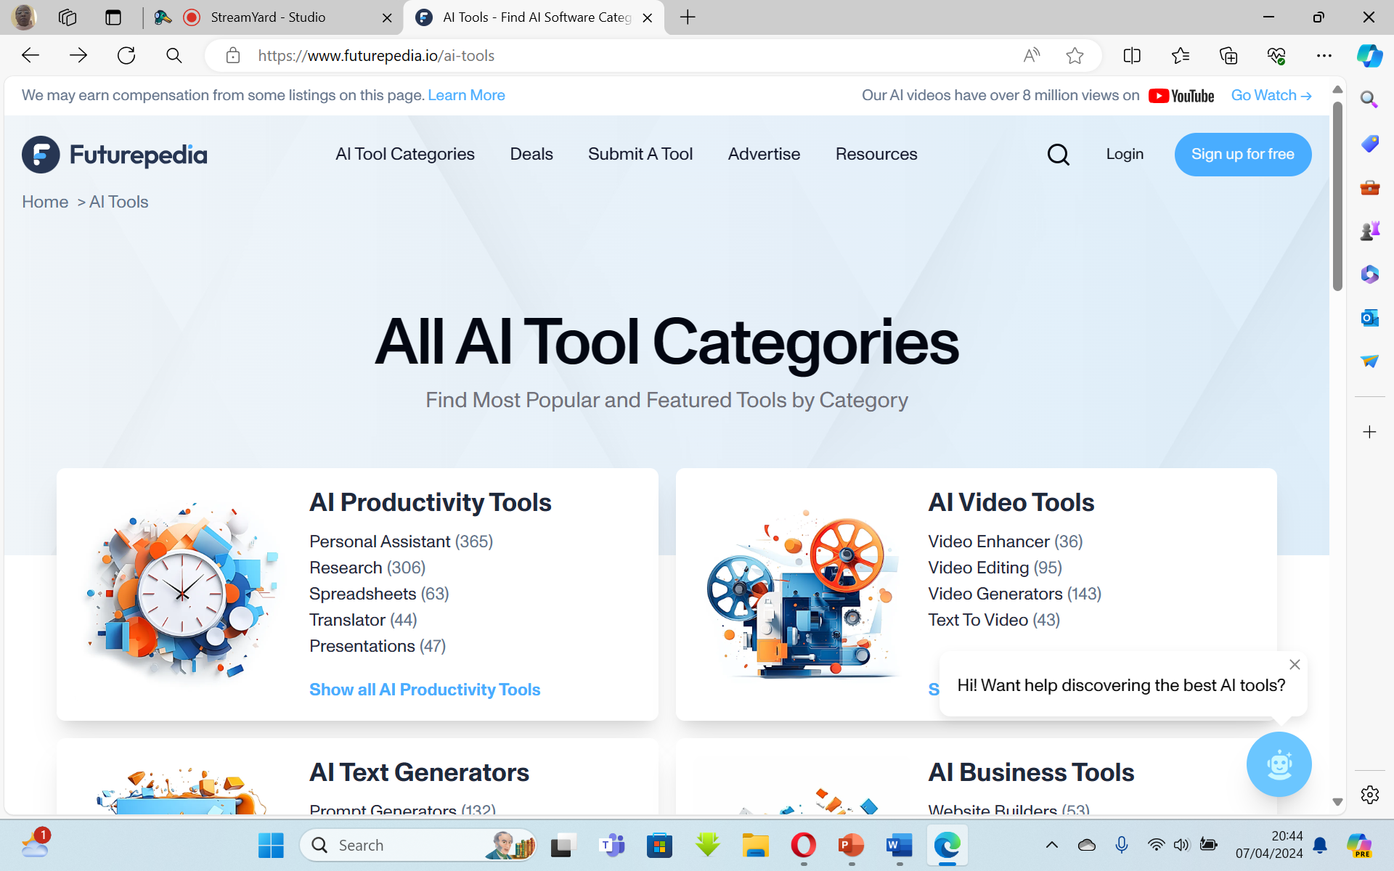

Slide 15
THANK YOU

