Slide 1
Ensuring Ethical Practices: Leveraging AI for Academic Research Writing

Slide 2
Introduction
In today’s academic landscape, ethical practices are crucial for upholding the integrity of research. Leveraging AI for academic research writing can enhance efficiency and accuracy.
This workshop will explore the ethical considerations and best practices for leveraging AI in
academic writing.

Slide 3
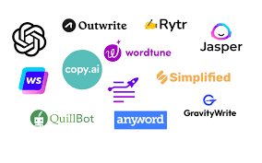
AI in Academic Research
The integration of AI technologies like ChatGPT, Gemini, Capilot, jasper, paperpal etc in academic research offers immense potential for enhancing efﬁciency and quality.
However, it also raises ethical concerns related to plagiarism, bias, and data privacy.

Slide 4
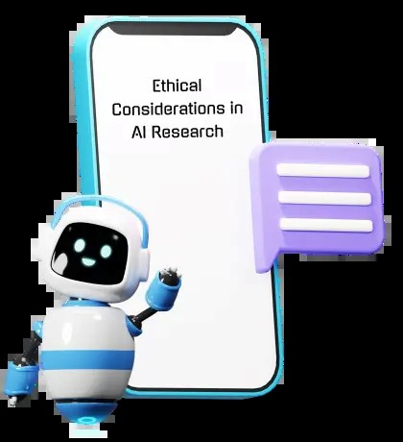
Ethical Guidelines
Establishing clear ethical guidelines is essential to ensure responsible and transparent use of ChatGPT in academic research. This includes promoting originality, respecting intellectual property rights, and maintaining data privacy.

Slide 5
Leveraging AI for Academic Research Ethically……Hands on
Choose a Topic:
Select a topic that interests you and aligns with the assignment requirements.
Ensure the topic is not too broad or too narrow for the scope of your Study
Ensure the research variables are well spelt out
Ensure the research title is such that has a research gap to fill

Slide 6
Leveraging AI for Academic Research Ethically……Hands on
2. Conduct Preliminary Research:
Gather background information on your chosen topic.
Familiarize yourself with existing literature and research to identify gaps or areas that need further exploration.

Slide 7
Leveraging AI for Academic Research Ethically……Hands on
3. Formulate a convincing Statement of problem:
Formulate a clear and concise statement of problem that summarizes the main argument or purpose of your research.

Slide 8
Leveraging AI for Academic Research Ethically……Hands on
4. Develop a Research Objectives and Question:
Craft specific research objectives and questions that your study will address. These questions should align with your study.

Slide 9
Leveraging AI for Academic Research Ethically……Hands on
5. Outline Your Paper:
Organize your ideas into a logical structure. Create an outline with sections such as introduction, literature review, methodology, findings, discussion, and conclusion.

Slide 10
Leveraging AI for Academic Research Ethically……Hands on
6. Write the Introduction:
Introduce your topic, provide background information, and present your research statement.

Slide 11
Leveraging AI for Academic Research Ethically……Hands on
7. Review of Literature:
Summarize existing research related to your topic.
Analyze and critique previous studies, identifying gaps or areas where your research contributes.

Slide 12
Leveraging AI for Academic Research Ethically……Hands on
8. Methodology:
Describe the methods you used to conduct your research.
Clearly outline your research design, population of study, sample size, method of data collection, method of data analysis.

Slide 13
Leveraging AI for Academic Research Ethically……Hands on
9. Present Your Findings:
Share the results of your research in a clear and organized manner.
Use tables, graphs, or charts to enhance data presentation.

Slide 14
Leveraging AI for Academic Research Ethically……Hands on
10. Discussion:
Interpret your findings and discuss their implications.
Relate your results back to your thesis statement and research questions.

Slide 15
Leveraging AI for Academic Research Ethically……Hands on
11. Conclusion:
Summarize the key points of your paper.
Discuss the broader implications of your research and suggest areas for future study.

Slide 16
Leveraging AI for Academic Research Ethically……Hands on
12. Cite Sources:
Use proper citation style (e.g., APA 6th or 7th edition) to give credit to the sources you used.
Create a bibliography or works cited page.

Slide 17
Leveraging AI for Academic Research Ethically……Hands on
13. Edit and Revise:
Review your paper for clarity, coherence, and consistency.
Check for grammatical and formatting errors (give to experts to assist you go through your entire study)

Slide 18
Ensuring Authenticity
Maintaining the authenticity of research work while leveraging ChatGPT is a critical ethical consideration. Researchers must strive to uphold academic integrity and ensure that AI-generated content is
appropriately attributed.

Slide 19
Guarding Against Bias
Addressing potential bias in AI- generated content is paramount. Researchers must be vigilant in identifying and mitigating biases to uphold the integrity and objectivity of academic writing.

Slide 20
Data Privacy Protection
Respecting data privacy is fundamental when utilizing AI tools including ChatGPT for academic research. Safeguarding sensitive information and ensuring compliance with privacy regulations are pivotal ethical considerations.

Slide 21
Best Practices
Implementing best practices such as cross-veriﬁcation of AI-generated content, thorough citation management, and regular ethical audits can uphold the integrity of academic research using AI tools.

Slide 22
Transparency and Disclosure
Maintaining transparency and providing full disclosure regarding the use of AI tools like ChatGPT in academic research is essential.
Researchers should openly acknowledge the contribution of AI in their work.

Slide 23
Future Implications
As AI continues to advance, the ethical implications of utilizing ChatGPT in academic research will evolve.
It is essential to anticipate and address future ethical challenges proactively.

Slide 24
Conclusion
In conclusion, understanding and adhering to ethical principles is essential for the responsible utilization of ChatGPT in academic research writing. By embracing ethical guidelines and best practices, researchers can harness the potential of AI while upholding academic integrity.

Slide 25
Thank You for Listening!

